Slide 1
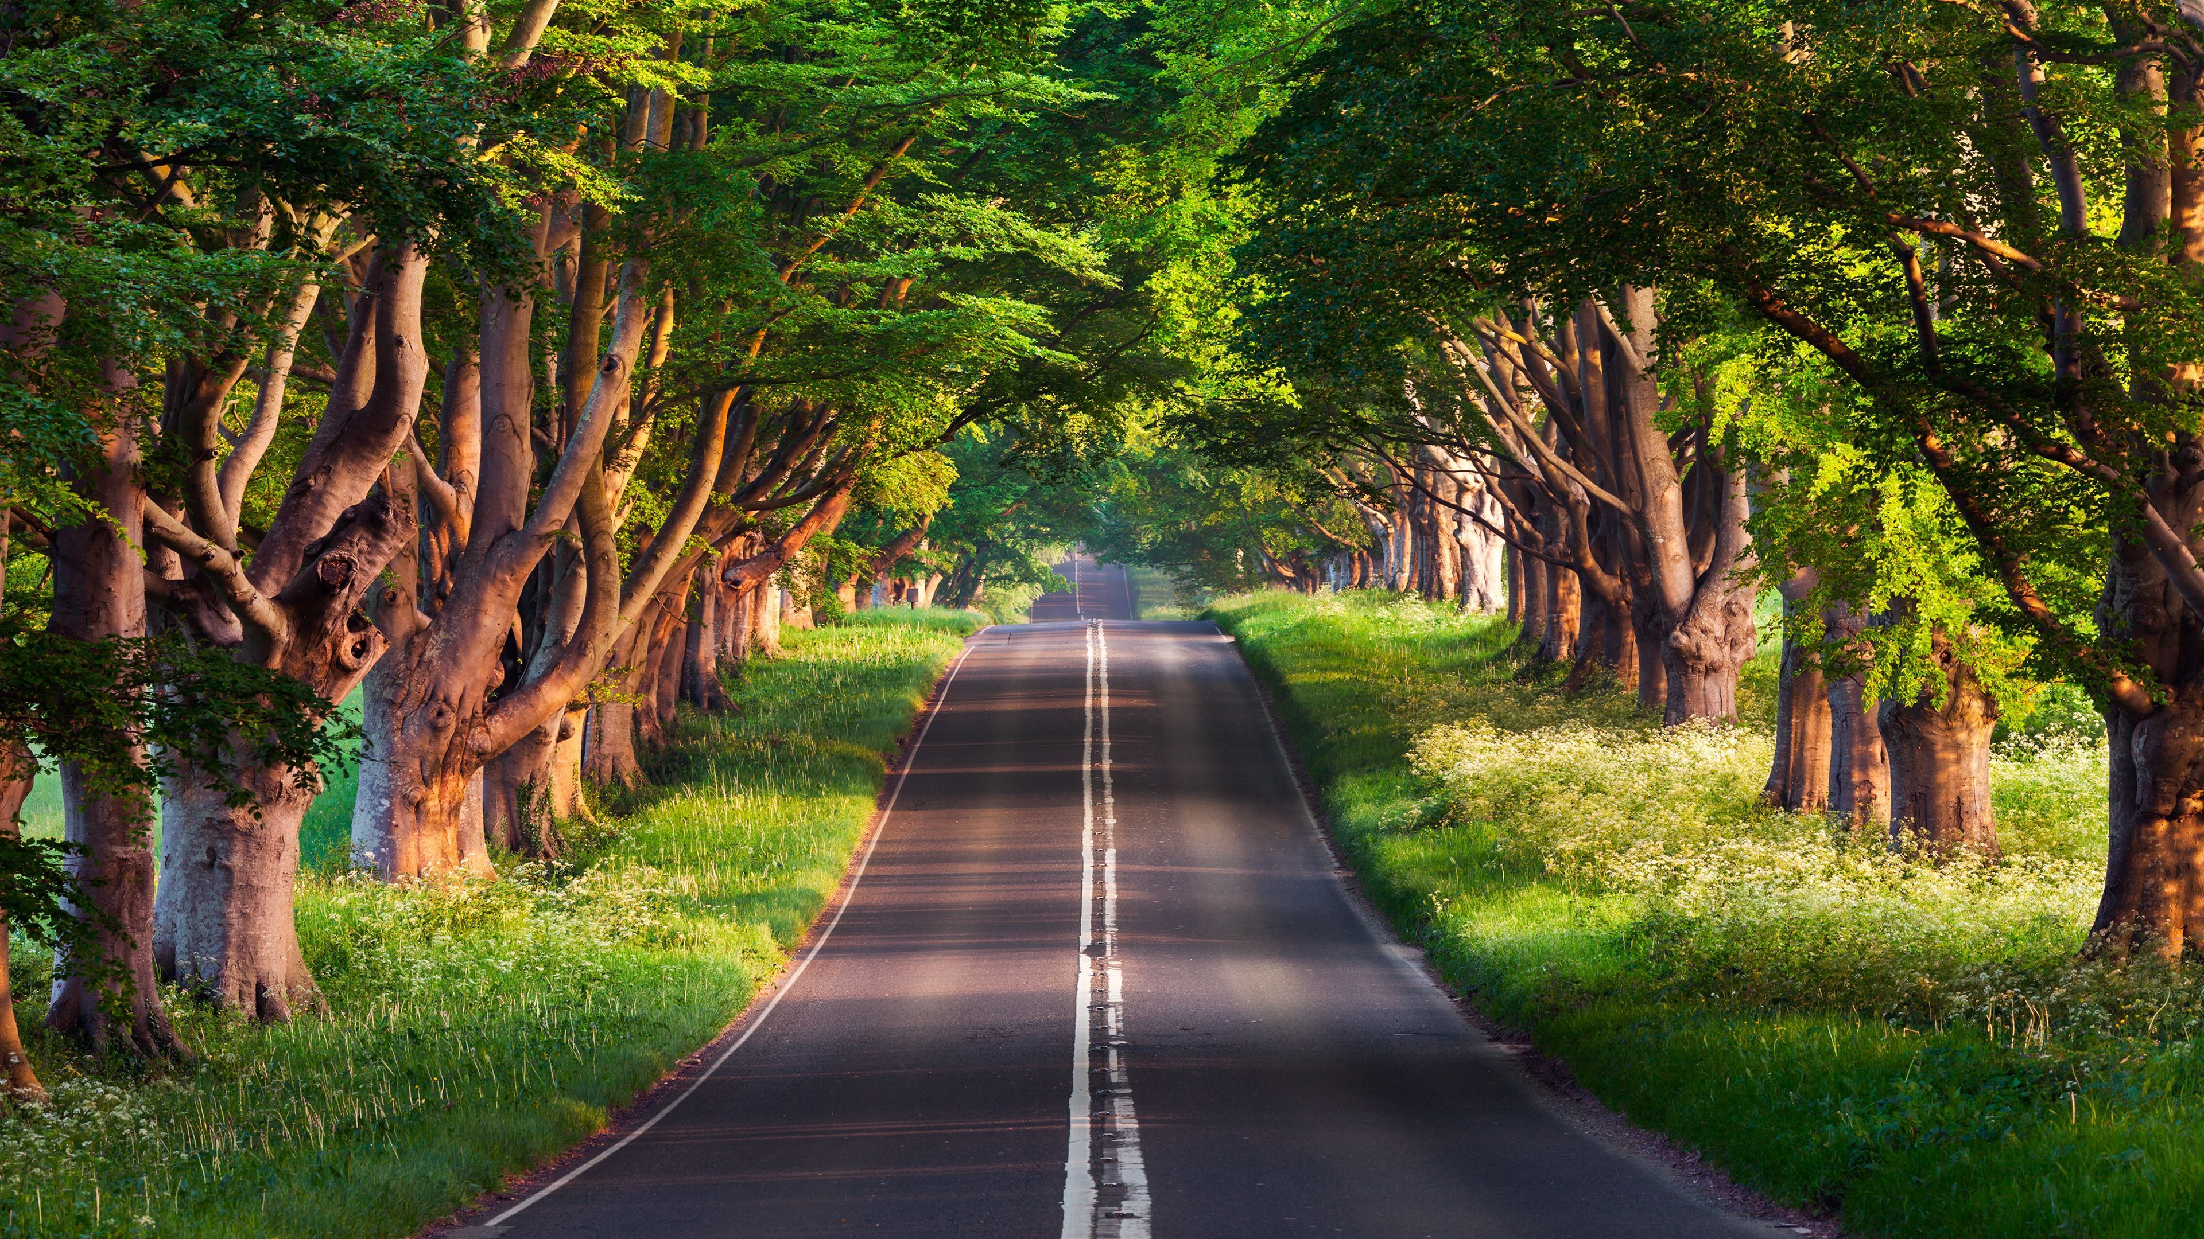
ENVIRONMENTAL STUDIES ASSIGNMENT
NAME : ABHISHEK CHOUDHARY
ROLL NO. : 20E068
SUBMITTED TO:
JYOTI MITTAL MAM

Slide 2

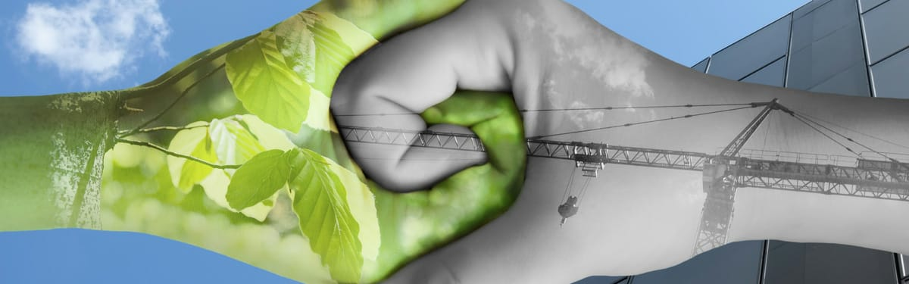
IN THIS PPT WE WILL GET TO KNOW ABOUT
In This PPT You Will Get To Know About :
REAL MEANING OF GREEN CHEMISTRY
CASE STUDY : GREEN INITIATIVE BY GOVERNMENT OF INDIA
📌📌

Slide 3


GREEN
CHEMISTRY
Green chemistry is the design of chemical products and processes that reduce or eliminate the use or generation of hazardous substances.
Green chemistry applies across the life cycle of a chemical product, including its design, manufacture, use, and ultimate disposal.

Slide 4

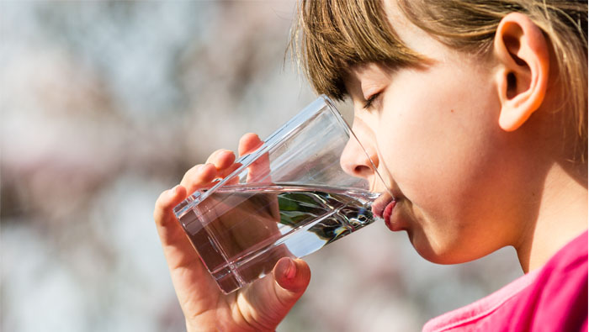
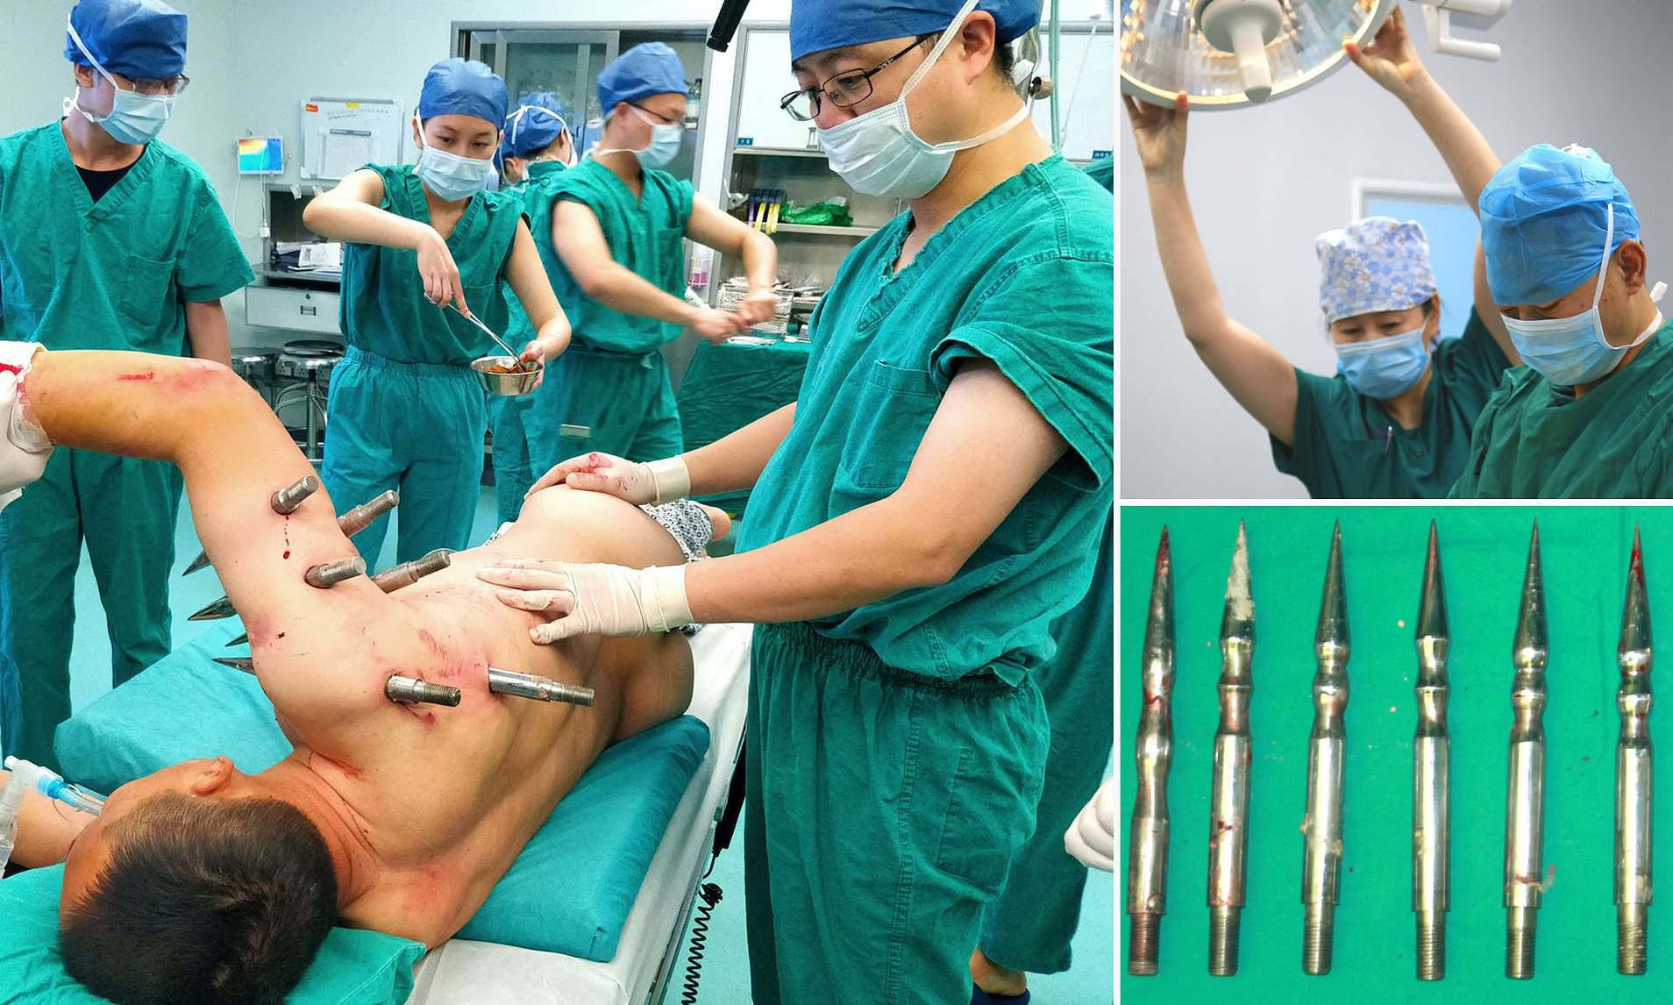
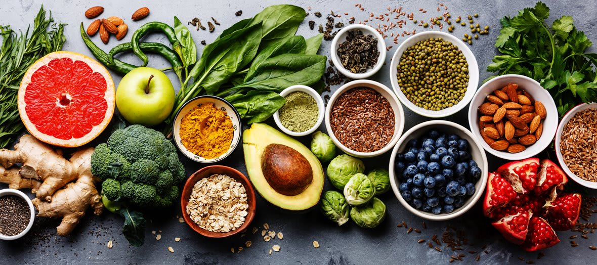

WHY DO WE NEED TO PRACTICE GREEN CHEMISTRY ?
Clean air to breathe
Non hazardous materials are released into the environment which leads to cleaner air and causes less damage to the lungs .also the usage of such environment friendly materials are a boon against air pollution.
Clean water to drink
Sources of drinking water like rivers lakes and ponds etc , are saved from being polluted by non hazardous chemical materials.
$$×$$
Increase in safety of workers
Less degrading and spoiling of food products
Due to use of non accidental and non hazardous machines and materials industry workers are saved from accidental explosion and health damages which can be life saving boon for the industry and also for the workers.
Food products will be safer from insects and worms and will be more healthy and nutritious and will take more time to rot and become spoiled and useless

Slide 5
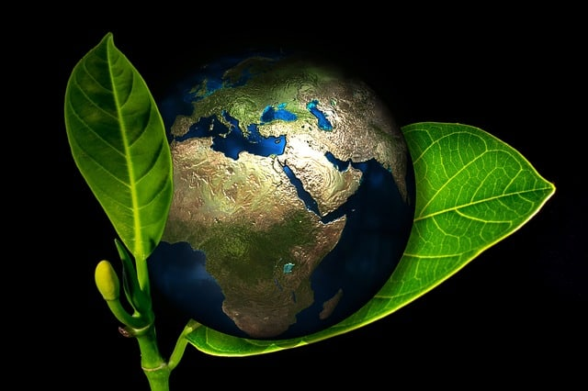
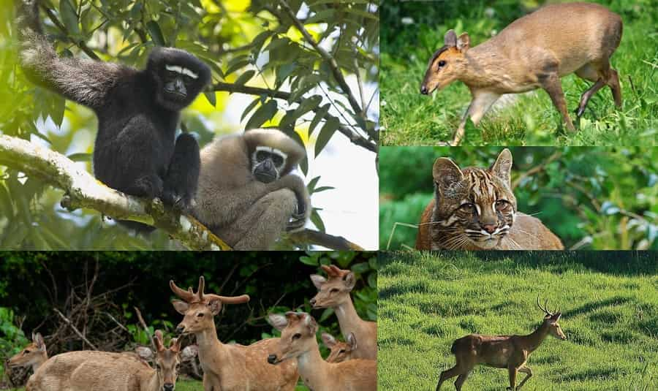
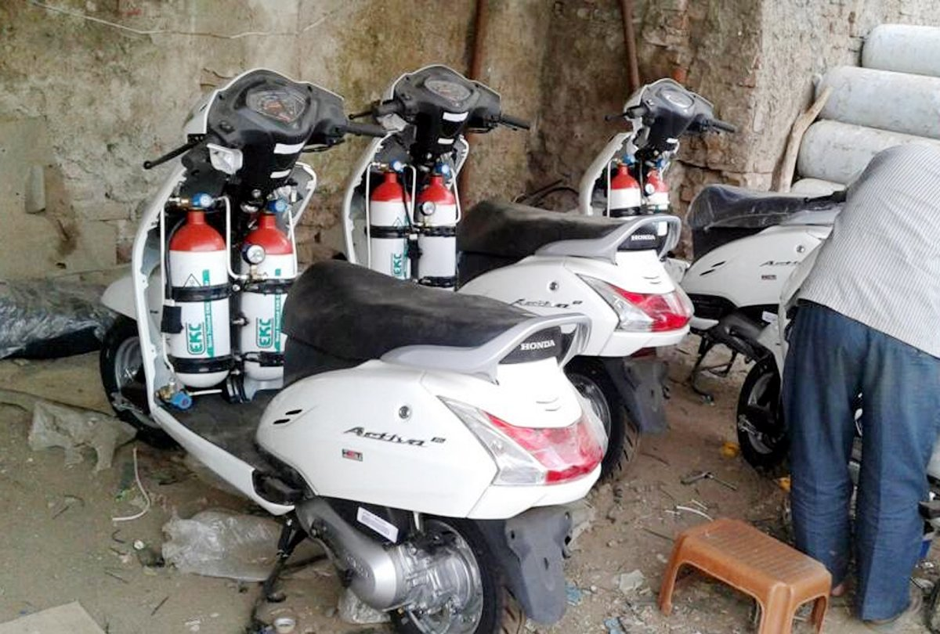
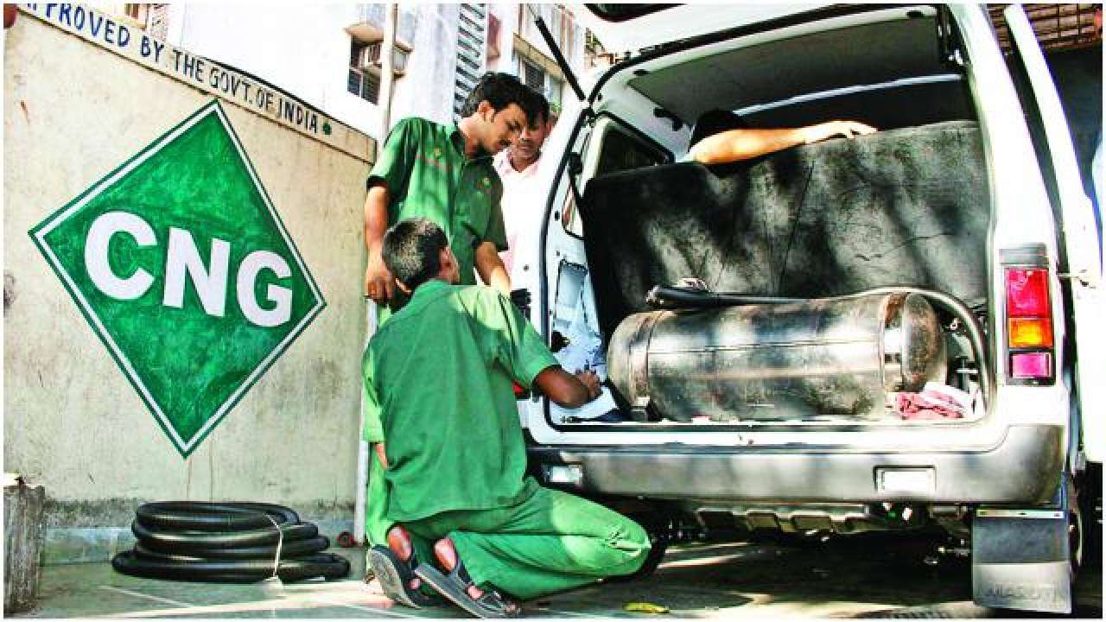

Plants and animals suffer less harm from toxic chemicals in the environment
📌
Decrease in the rate of global warming
Recovery of ozone layer
Reduction in the production of greenhouse gases
📌
📌
📌
Reduced use of petroleum products, slowing their depletion and avoiding their hazards and price fluctuations
📌
Increased consumer sales by earning and displaying a safer-product label (e.g., Safer Choice Labelling
📌

Slide 6

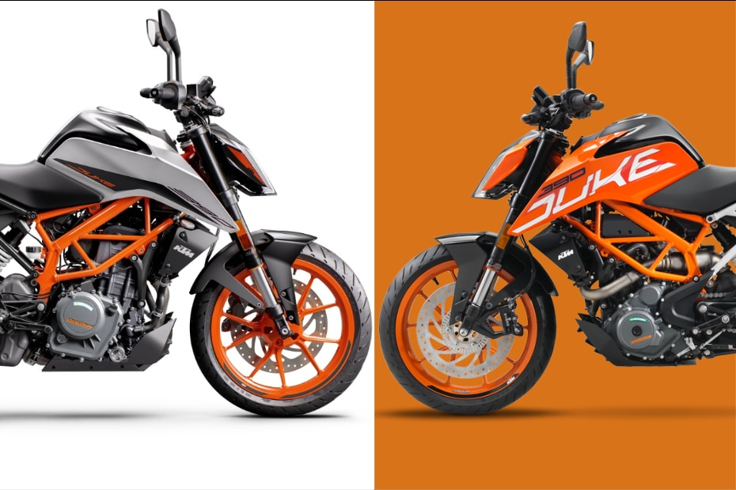
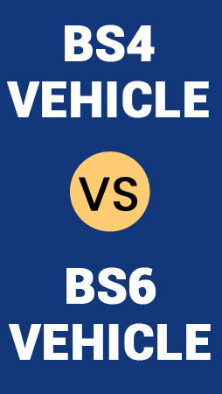
Recently INDIA transited from BS4* to BS6* in motor vehicles
This Transition is an application of Green Chemistry

Slide 7

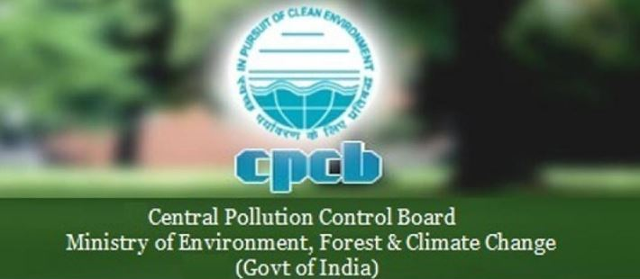
Firstly let us understand what was the need for transition from BS4 to BS6
India has the most polluted cities in the world.
30 Indian cities figure in the Top 100 Most Polluted Global Cities as per data published by World Health Organization in May 2016.
Air pollution is the fifth leading cause of death in India.
There is a strong opinion emerging among policy makers and environmental groups in India that stricter emission standards need to be implemented for all kind of vehicles in the country.
The governing body, Bharat Stage Emission Standards (BSES), regulates the output of pollutants from vehicles plying in the country. The Central Pollution Control Board which falls under the Ministry of Environment, Forest and Climate Change sets the standards to regulate emissions from vehicles in India.
BS standard is generally applicable to all the vehicles that are running in the country.

Slide 8

What is
Bharat Stage IV (BS4) ?
BS stands for Bharat Stage and are set by the central pollution control board.
April 2016
BS4 Fuel
BS4 Petrol engine
Multi-Point Fuel Injection (MPFI)
Converters to Reduce the Harmful Oxides And Hydrocarbons
BS4 Diesel Engine
Common Rail Direct Injection (CRDI)
Turbocharger
Exhaust Gas Re Circulation System (EGR)
SULPHUR CONTENT ALLOWED : 50 PPM

Slide 9
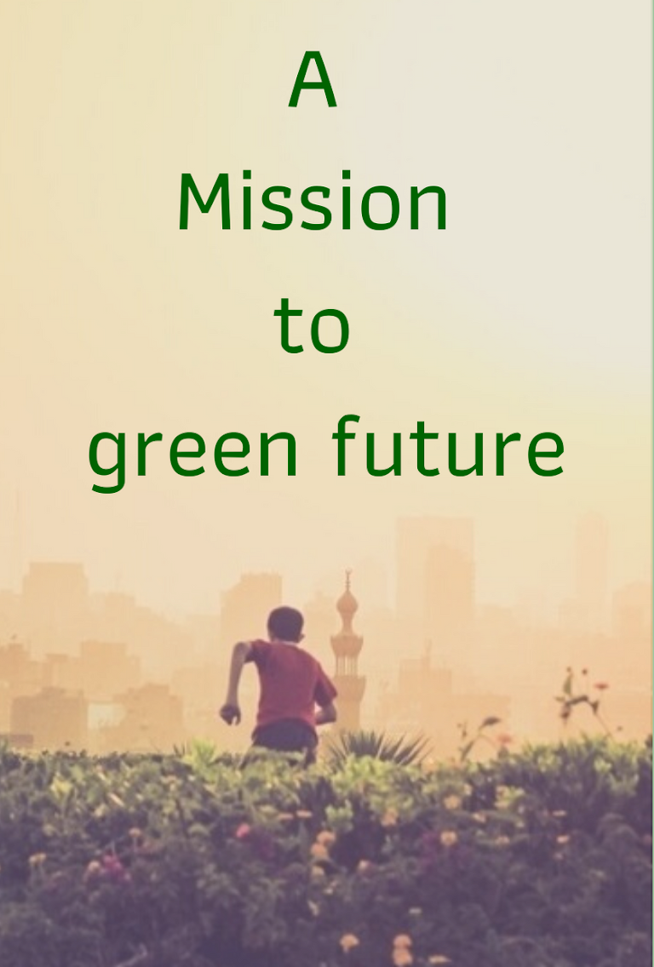
So What Basically is BS 6
MANDATES INSTALLING FILTERS IN VIHICLES TO CUT PARTICULATE MATTER FROM EXAUST
COMPYLING VIHICLES ARE LESS POLLUTING DUE TO LESS EMMISION OF TOXIC GASES
MANDATE ON BOARD DIAGNOSTICS FOR VIHICLE MAINTENANCE
% REDUCTION PLANNED FOR OXIDES OF NITROGEN
70% - DIESEL ENGINE
25% - PETROL ENGINE
WAS IMPLEMENTED FROM APRIL 1, 2020

Slide 10
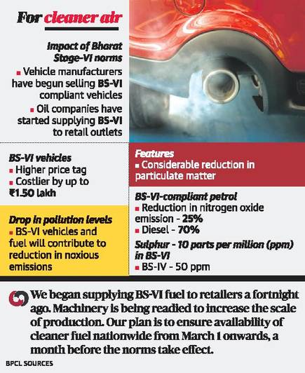
DIFFERENCE BETWEEN VIHICULAR EMISSION BY BS4 AND BS6 ENGINES
Fuel Type | Pollutant Gases | BS6 (BSVI) | BS4 (BSIV)
Petroleum Distillate Vehicle | Nitrogen Oxide (NOx) Limit | 60mg | 80mg
 | Particulate Matter (PM) Limit | 4.5mg/km | -
Diesel Fuel Vehicle | Nitrogen Oxide (NOx) Limit | 80mg | 250mg
 | Particulate Matter (PM) Limit | 4.5mg/km | 25mg
 | HC + NOx | 170mg/km | 300mg

Slide 11
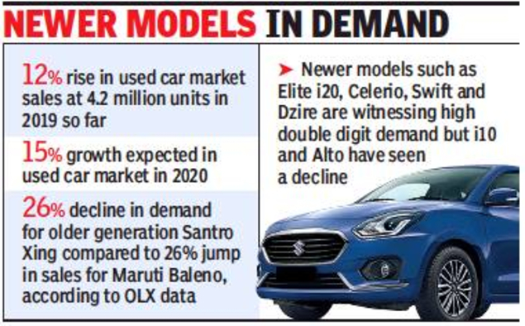
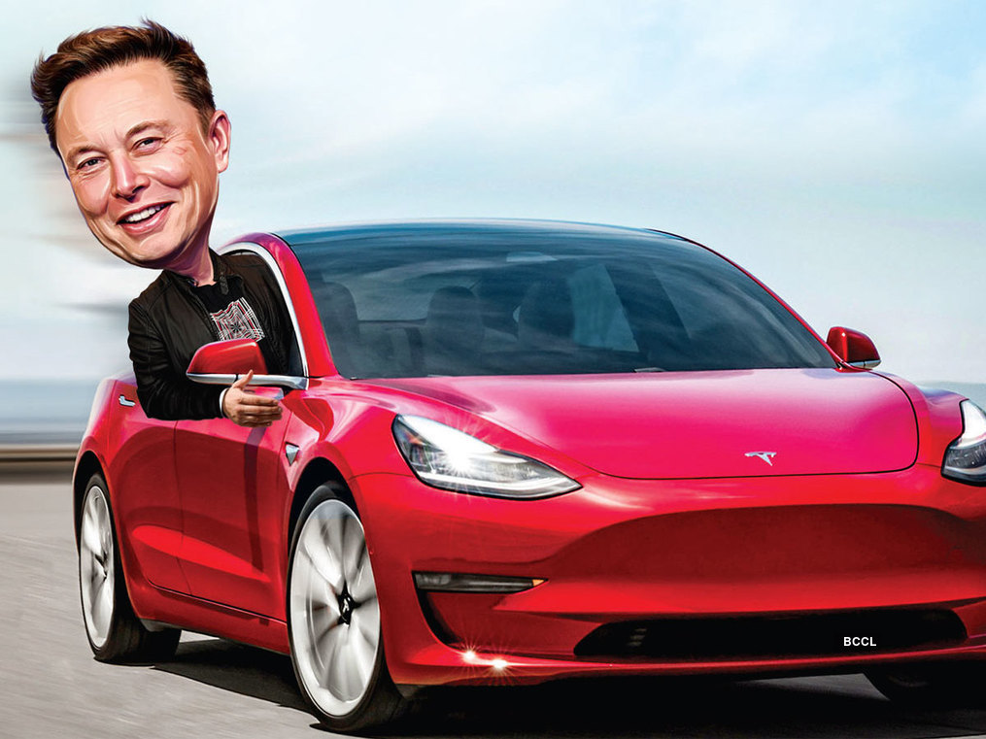
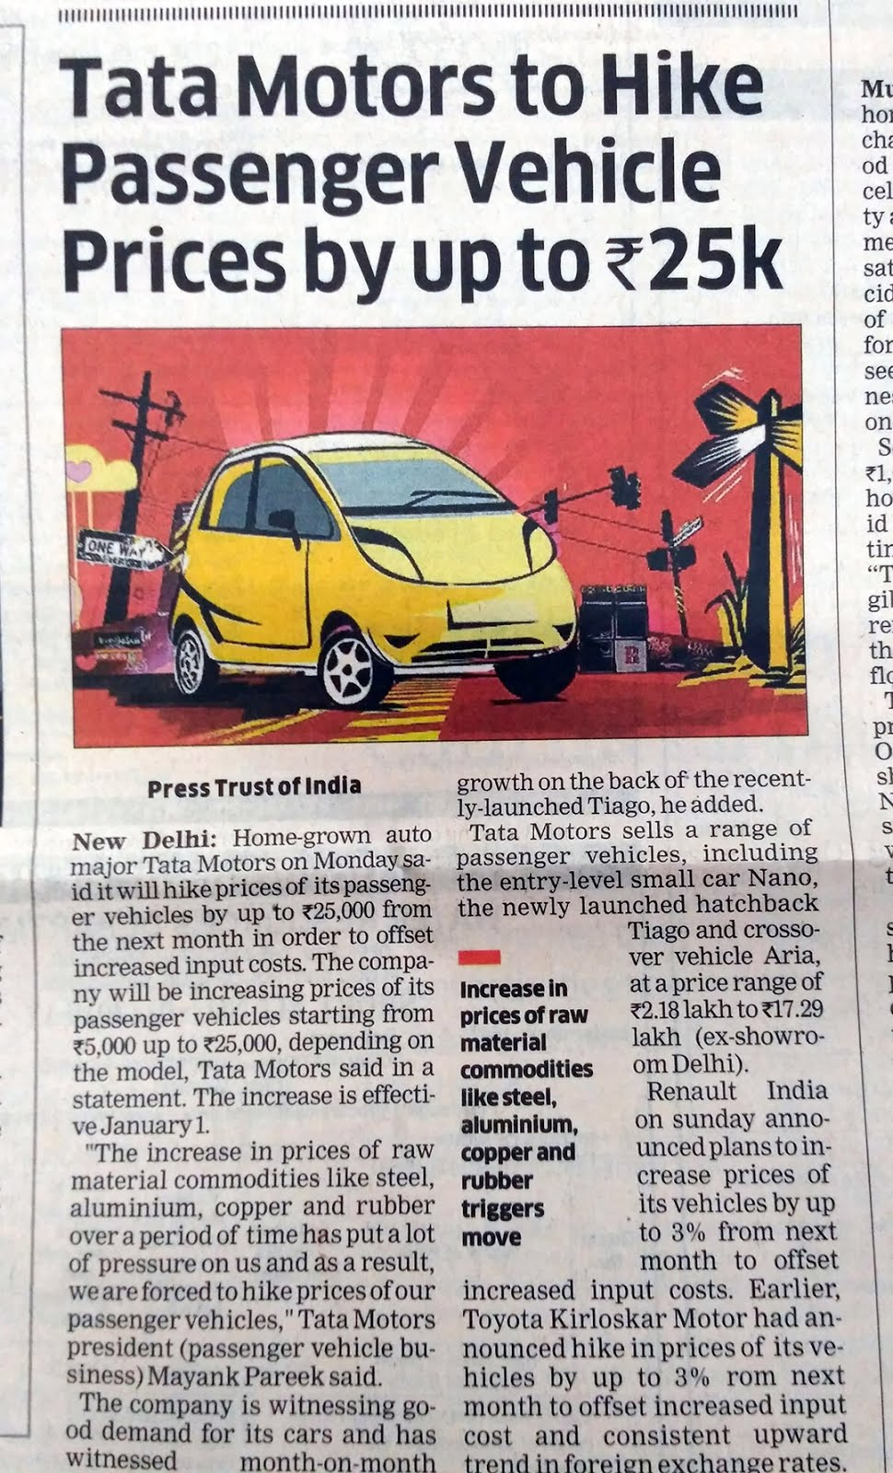
WHAT SHOULD BE EXPECTED IN FUTURE ?
Then, the automakers will have to make investments on their end too in order to speed up the research and development process and improve their own infrastructure – like the manufacturing plants – to make their offering higher BS compliant.
📌
This, eventually, will make owning an internal combustion engine powered car more expensive to own, and maintain.
📌
📌
To sum it up, India is making an effort to reach the global standards and hence, a lot of changes in the trends, sales and choices made by customers are expected in the coming years.

Slide 12
THE LEAST WE CAN DO ON OUR PART , TO PRACTICE GREEN CHEMISTRY , IS “NOT TO HARM OUR ENVIRONMENT ANY FURTHER”
THANK YOU
“Protecting Our Planet Starts with You”

